Slide 1



UVSafe
Skin color classification

Slide 2
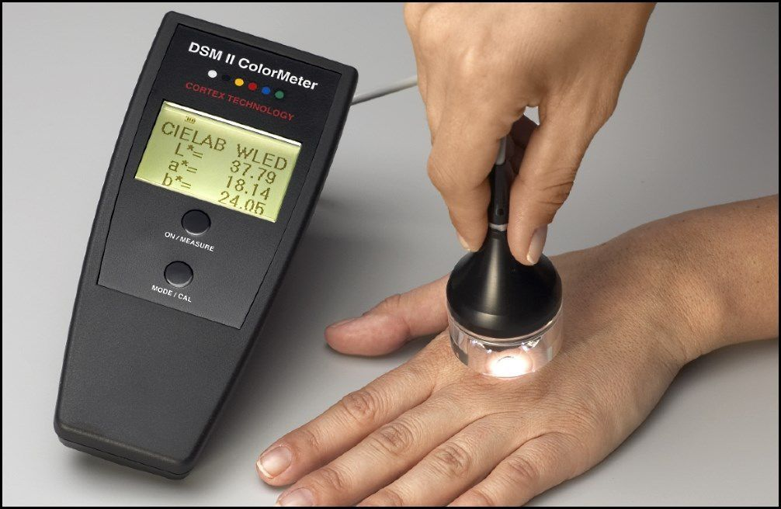
The Base Method
Presented in the paper
Variations in skin colour and the biological consequences of ultraviolet radiation exposure (S. Del Bino and F. Bernerd 2013)
A method for classifying Skin Type based on spectrometer/colorimeter readings of the L*a*b* colorspace

Slide 3
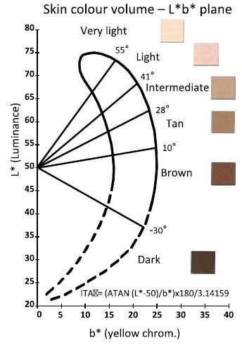
The Base Method
ITA – Individual Typology Angle

Slide 4
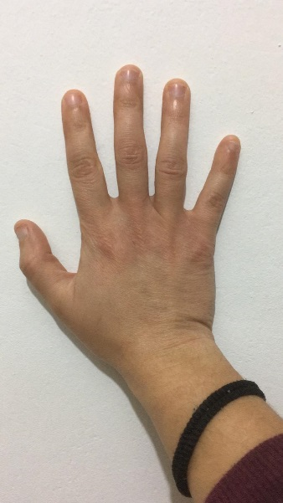

Our Method - Overview
Use a phone captured image
Convert to L*a*b*
Colors pace
And calculate ITA
Extract pure skin color
Classify according to ITA
Type 4

Slide 5
The HSV Color Space

Slide 6
Assumptions/Requirements
Photo of the back of the hand
White Background
Indoor White Light
No Flash

Slide 7
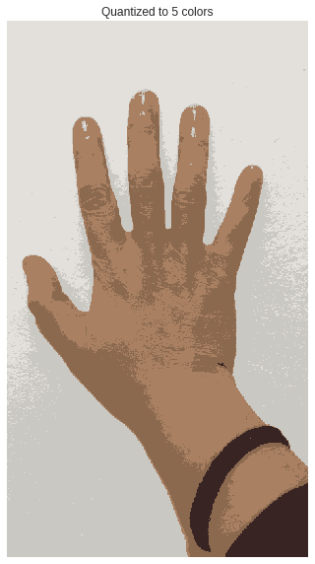
Finding the Dominant Skin Color
Skin is identified within the image by using color values in the HSV color space
To make sure only the dominant skin colors are identified, the entire image is quantized to 5 dominant colors using k-means Clustering

Slide 8

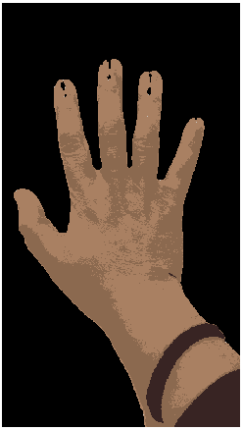
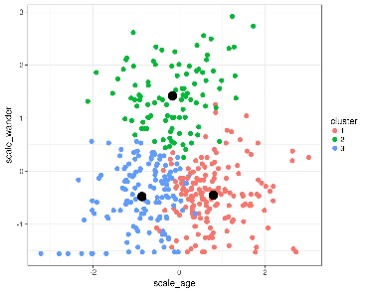
Finding the Dominant Skin Colors
Identify Skin within the image
using HSV
K-means clustering

Slide 9
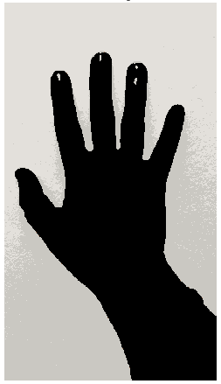



Extract Mean Color and Adjust to Background lighting

Slide 10
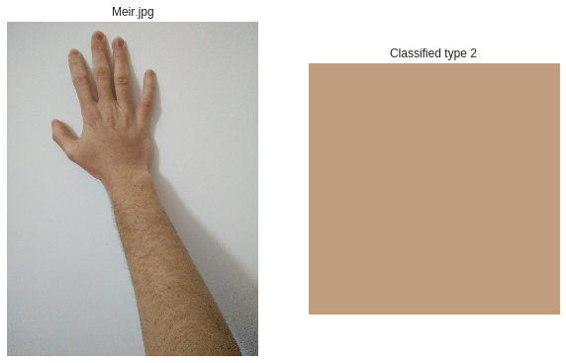
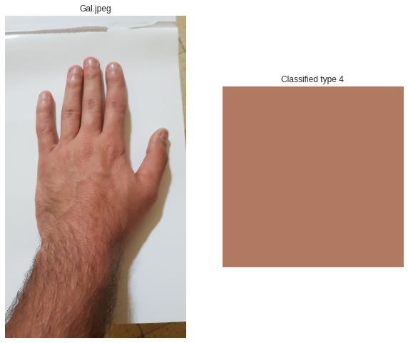
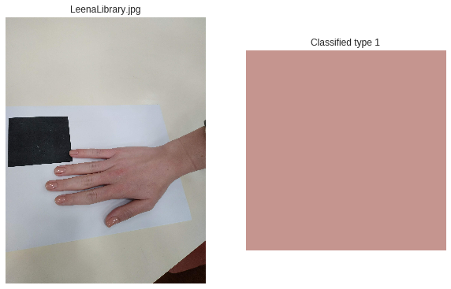
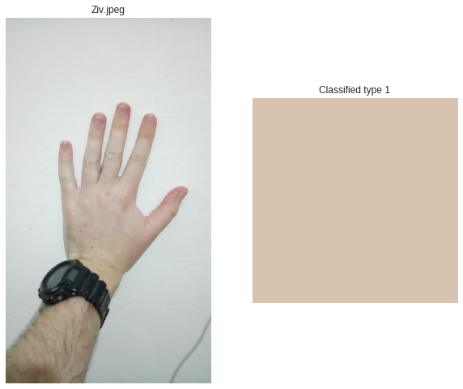
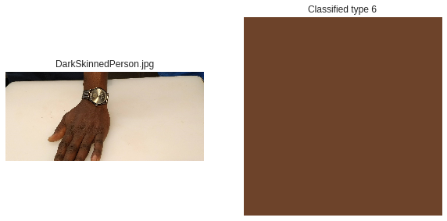
Results

Slide 11



Implementation
The algorithm was implemented in Python using the OpenCV image processing and CV library
It is executed by an Azure Functions server running the Python code

Slide 12
Acknowledgement
Portions of the research in this work use the
Multispectral Skin/Face Database of the Bonn-Rhein-Sieg University of Applied Sciences
(http://isf.h-brs.de/en/skin-db/)
Thank you for letting us use your database for this work

